Slide 1
Support to the Ministry of Education of the Republic of Azerbaijan for Further Adherence of the Higher Education System to the European Higher Education Area
(AZ-ad-EHEA)
Reijo Aholainen, RTA Resident Twinning Adviser
This project is funded by the European Union

Slide 2
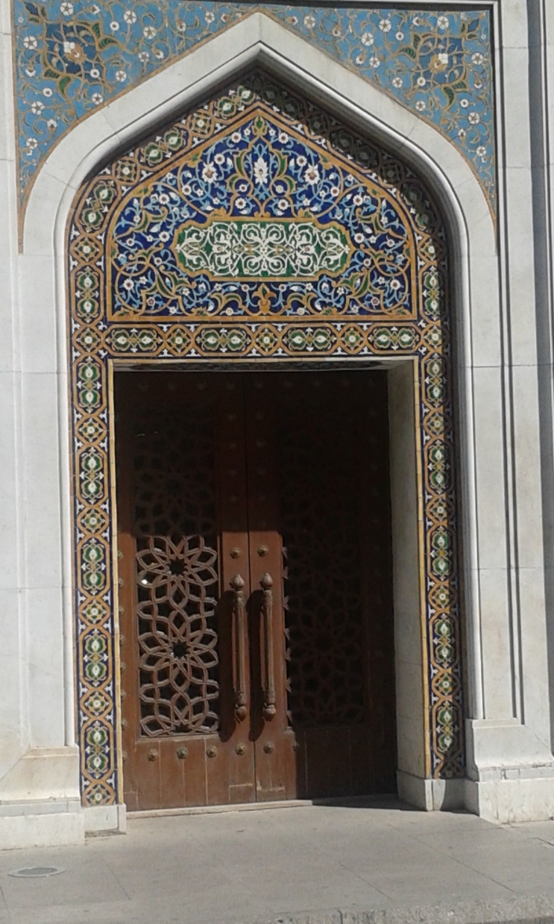
The Purpose
Increase institutional capacities of the Ministry of Education and other key institutions
Development of Azerbaijan higher education policies related to the EHEA
Implementation of the EHEA objectives and reference tools in Azerbaijan
This project is funded by the European Union

Slide 3
Project Objective
Further development of Azerbaijan’s higher education system
increased integration in the European Higher Education Area (EHEA)
This project is funded by the European Union

Slide 4
Mandatory Results
Legislative framework
Capacity Building of MoE Staff
The AzQF sections relevant for higher education
Standards and Guidelines for QA in HE in Azerbaijan
This project is funded by the European Union

Slide 5
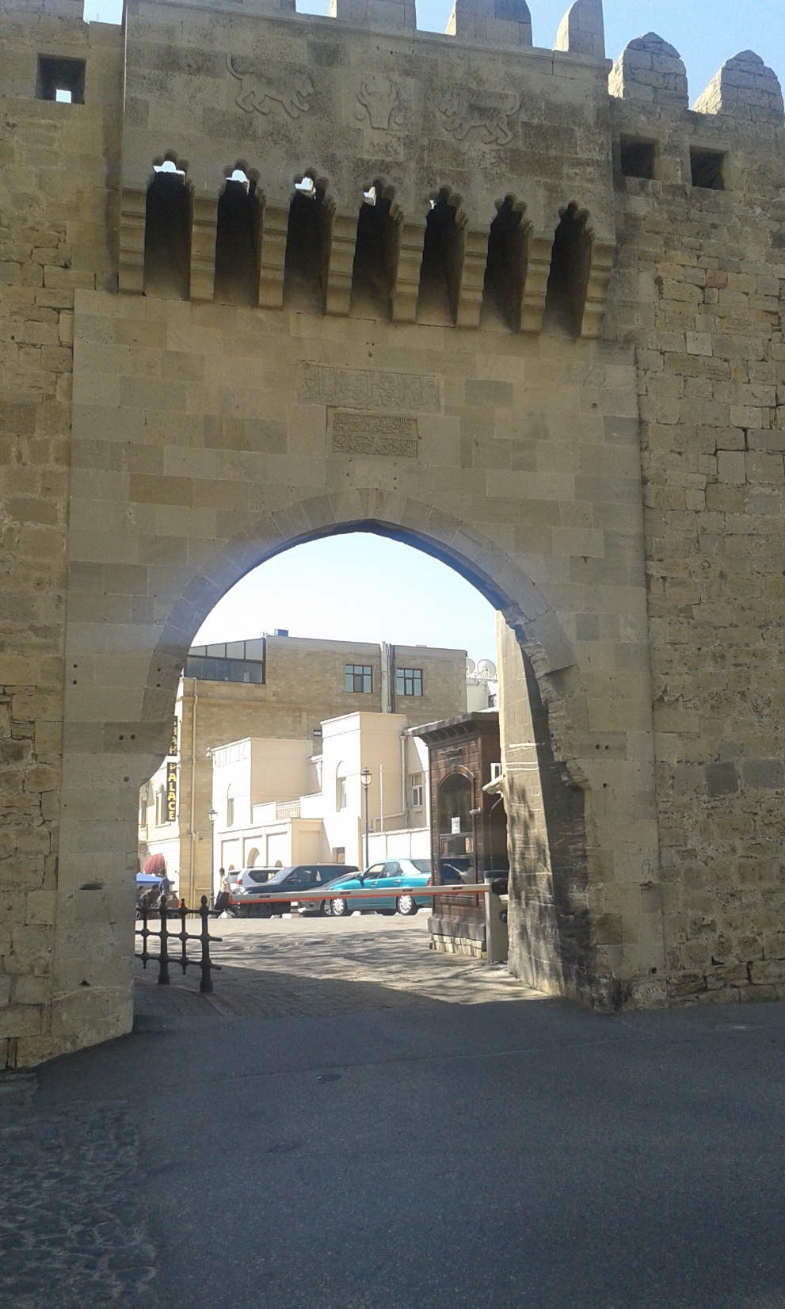
Mandatory Result 4: Standards for Quality Assurance in HE
Development of Azerbaijan Higher Education Standards and Guidelines for Quality Assurance in line with the European Standards and Guidelines
Pilot evaluation in three HEIs
This project is funded by the European Union

Slide 6
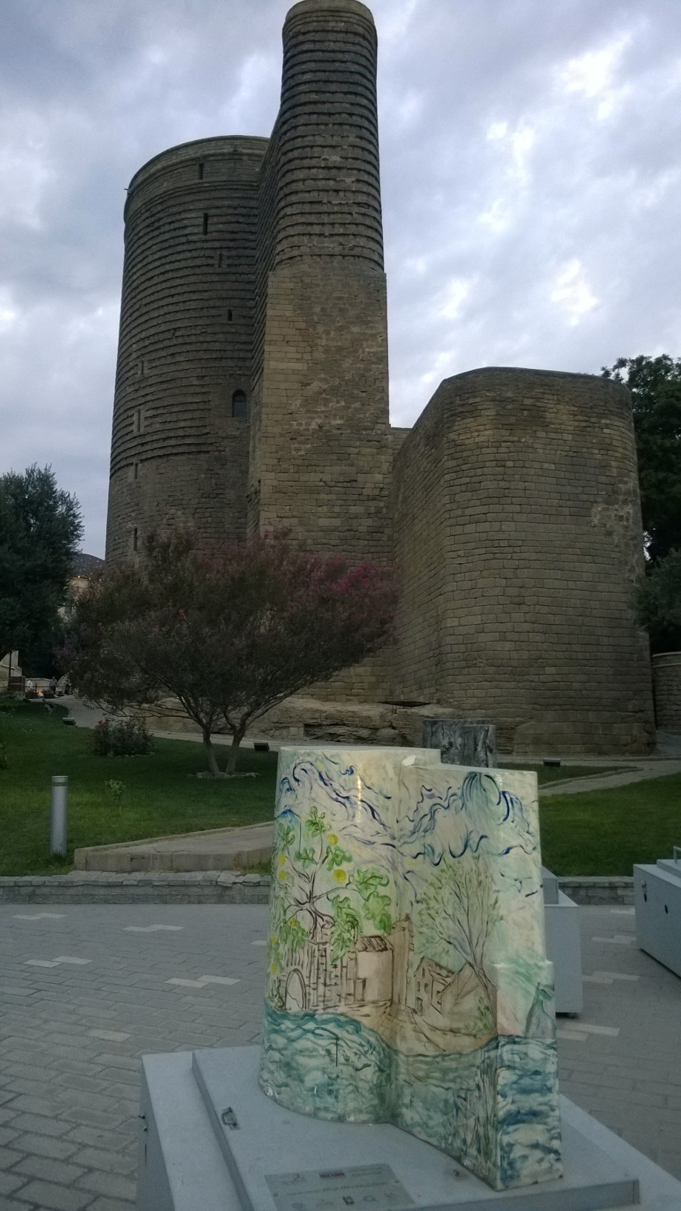
Mandatory Result No 3: Development of the Azerbaijan QF
Development of AzQF sections relevant for higher education are developed in line with the EHEA QF in cooperation with HEIs.
A roadmap for the full implementation of the AzQF in higher education
This project is funded by the European Union

Slide 7
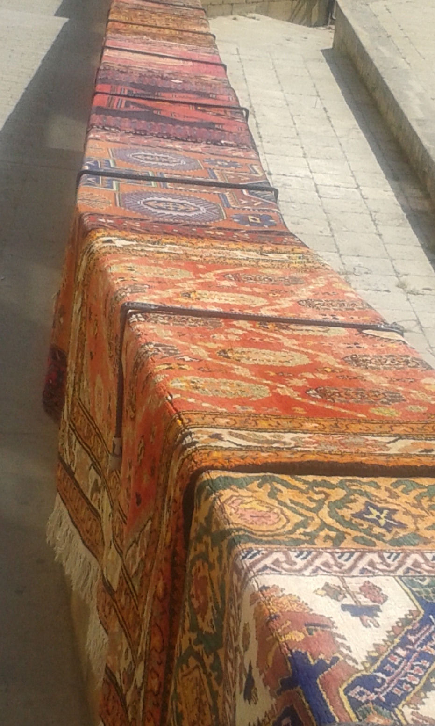
Mandatory Result 2: Coordination and Networking Capacity
Enhancing the coordination and networking capacity of the Ministry and stakeholders
Improve institutional architecture
This project is funded by the European Union

Slide 8
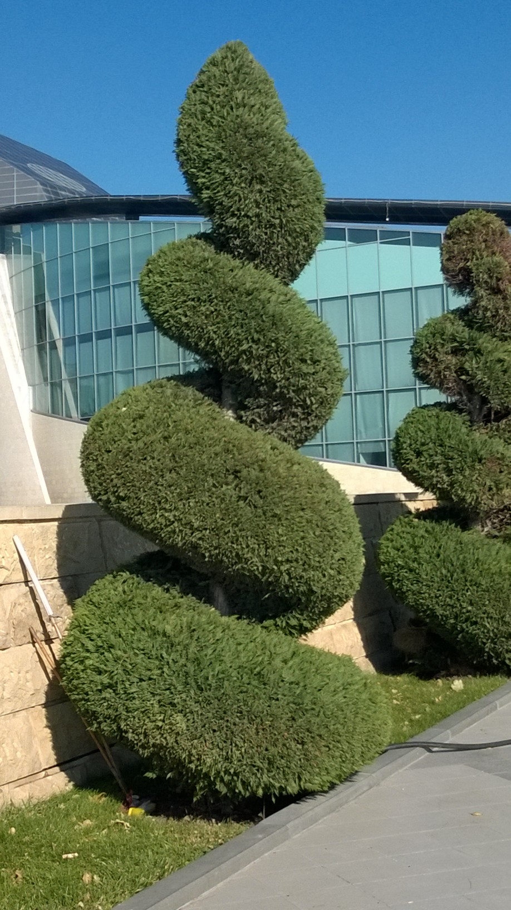
Mandatory Result 1: Legal Framework
Review of Azerbaijan relent Higher Education legislation
Concrete recommendations for adapting legislation relevant to Quality Assurance and Azerbaijan Qualification Framework relevant to Higher Education
This project is funded by the European Union

Slide 9
Calendar of Activities, 1st year
Sep 2015 | Act 1.1. Review of Legal Framework 5 missions | Act 2.1. Progress review 2 missions
Oct 2015 |  |  |  | Act 4.2 Mapping of Accreditation 2 missions
Nov 2015 |  | Act 2.5. Training Needs Analysis 2 missions
Dec 2015 |  |  |  | Act 4.1.a Update on Bologna context 6 training missions
Jan 2016 |  | Act 2.2 Coordination of EHEA Reforms 3 missions | Act 3.1. EHEA and QF EHEA Training 7 missions
Feb 2016
Mar 2016 |  | Act 2.7. Communication strategy 2 missions | Act 3.2. AzQF Gap Analysis 4 missions
Apr 2016 |  |  |  | Act 4.3. Standards and Guidelines for QA in HE 6 missions
May 2016 |  | Act 2.3. Roadmap for Institutional Arrangements 2 missions
June 2016 |  |  | Act 3.3. Aligning HE Qualifications with QF 2 missions
July 2016 |  |  |  | Act 4.1.b Study visit to Finland & Estonia
Aug 2016 | This project is funded by the European Union This project is funded by the European Union

Slide 10
Calendar of Activities, 2nd year
Sep 2016 | Act 1.2. Recommendations on legislation harmonising HE legislation with legal framework 10 missions | Act 2.4. Steering and Coordination 3 missions | Act 3.3. Aligning HE Qualifications with HE QF 2 missions | Act. 4.3. AzSG 2 missions
Oct 2016 |  | Act 2.6.a Benchmarking Organisational Arrangements 2 missions |  | Act 4.4. Fostering of Self-Evaluation Capacity 6 missions
Nov 2016
Dec 2016 |  | 2 Act 2.6.b Internships in Finland and Estonia | Act 3.5. Enhancing Practices and Procedures Proposal for reflecting HE of AzQF in national recognition 4 missions
Jan 2017
Feb 2017 |  |  |  | Act 4.5. Pilot Evaluations Test run of the AzSG with 3 HEIs. 10 missions
Mar 2017
Apr 2017 |  | Act 2.6.c Study visit to Brussels | Act 3.4. Implementation of AzQF 3 missions
May 2017 |  |  |  | Act 4.6. Analysis of the Pilots 8 missions
June 2017
July 2017
Aug 2017 | Closure Meeting This project is funded by the European Union

Slide 11
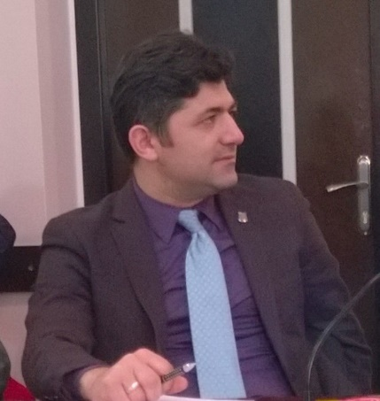
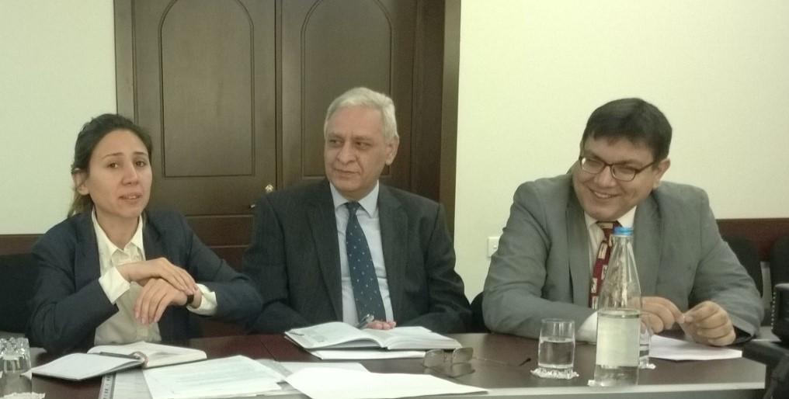
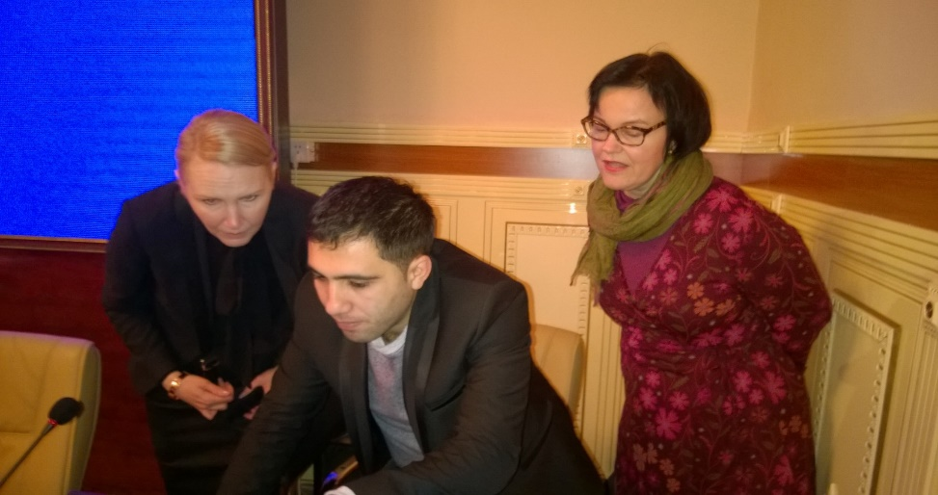
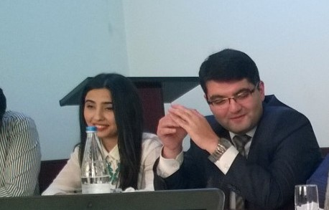
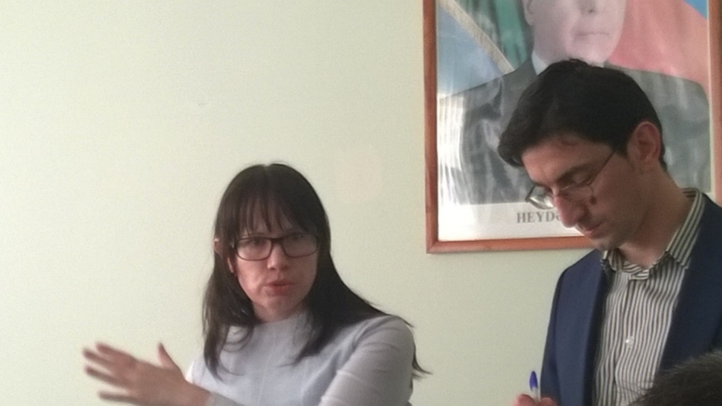
EHEA Twinning Project Resources: EU Funding 1.3 M€ - 470 STE Days
This project is funded by the European Union

Slide 12
Support to the Ministry of Education
of the Republic of Azerbaijan for Further Adherence of the Higher Education System to the European Higher Education Area
www.ehea.edu.az
This project is funded by the European Union

